Slide 1
JAVA WEB COMPILER
BY KARAN S
43110397

Slide 2
ABSTRACT:
The project is a Java Web Compiler developed using HTML, CSS, JavaScript, and Node.js.
It allows users to write, compile, and run Java programs directly in a web browser.
The HTML and CSS are used to design a user-friendly interface for code input and output display.
JavaScript handles the frontend logic, such as sending code to the backend and displaying results dynamically.
The Node.js backend receives the Java code, executes it using the system’s Java compiler, and returns the output to the browser.
The project helps users practice and test Java code online without needing to install any compiler locally.
It demonstrates the integration of frontend and backend technologies to create an interactive web-based application.
The main objective is to provide a simple, efficient, and accessible online platform for learning and executing Java programs.

Slide 3
EXISTING SYSTEM:
In the existing system, users need to install Java software (JDK) and use an offline IDE like Eclipse to write and run Java programs.
The setup process is often time-consuming and requires proper configuration of environment variables.
Beginners may face errors during installation, making it difficult to start coding quickly.
The existing system does not allow running Java code online, so users must depend on their local system.
There is no easy way to share or test Java code instantly without using external tools.
It is less convenient for students and learners who just want to practice simple Java programs.
Therefore, a web-based Java compiler is needed to overcome these limitations and make coding more accessible.

Slide 4
PROPOSED SYSTEM:
The proposed system is a web-based Java compiler that allows users to write, compile, and execute Java programs online.
It removes the need for manual installation of JDK or IDEs.
Users can access the compiler from any device through a web browser.
The frontend is designed using HTML, CSS, and JavaScript for a clean and easy-to-use interface.
The backend is developed using Node.js, which handles code execution and returns the output to the user.
The system provides instant results after running the Java code.
It helps students and learners to practice Java programs quickly and conveniently.
The main goal is to create a simple, efficient, and accessible online platform for Java coding practice.

Slide 5
HARDWARE REQUIREMENTS:
Processor: Intel Core i3 or above
RAM: Minimum 4 GB (8 GB recommended for smooth execution)
Hard Disk: At least 250 GB of storage
Monitor: 15-inch or above display
Keyboard and Mouse: Standard input devices
Network: Internet connection required for accessing the web compiler
Server System (for backend): Processor: Intel Core i5 or above
RAM: Minimum 8 GB
Storage: 500 GB or more

Slide 6
SOFTWARE REQUIREMENTS:
Operating System: Windows / macOS / Linux
Frontend Technologies: HTML, CSS, JavaScript
Backend Technology: Node.js
Compiler: Java Development Kit (JDK) installed on the server
Code Editor / IDE: Visual Studio Code (VS Code)
Web Browser: Google Chrome / Microsoft Edge / Mozilla Firefox
Package Manager: npm (Node Package Manager) for installing dependencies
Server Environment: Node.js runtime environment

Slide 7
MODULES:
User Interface Module: i) Designed using HTML, CSS, and JavaScript.
ii) Allows users to write Java code and view the output.
Code Editor Module : i) Provides a text area or editor where users can type or paste Java code.
ii) Supports basic editing functions like copy, paste, and clear.
Compiler Execution Module: i) Sends the user’s Java code to the backend (Node.js).
ii) Executes the code using the Java compiler (JDK) on the server.
Result Display Module: i) Receives the output or error message from the backend.
ii) Displays the result instantly on the web page.

Slide 8
MODULES (CONT):
Backend Module (Node.js) : i) Handles requests from the frontend.
ii) Runs the Java program and returns output or errors.
Error Handling Module: i) Detects compilation or runtime errors.
ii) Displays clear and readable error messages to the user.

Slide 9
MODULE DESCRIPTION:
The Java Web Compiler project is divided into several modules that work together to provide a smooth and efficient online coding experience.
The User Interface Module allows the user to interact with the system through a clean and responsive design. It is developed using HTML, CSS, and JavaScript, making it easy for users to type and execute Java programs directly from the web browser.
The Code Editor Module provides a text area where users can write or paste their Java code. It acts as the main workspace for the user and supports basic features like editing, clearing, and submitting code for execution.
The Compiler Execution Module handles the process of compiling and running the code. When the user clicks the run button, the Java code is sent to the backend, where it is executed using the Java Development Kit (JDK).

Slide 10
MODULE DESCRIPTION (CONT):
The Result Display Module receives the output or error messages from the backend and displays them instantly on the same page, allowing the user to view results in real time.
The Backend Module, developed using Node.js, manages the connection between the frontend and the Java compiler. It receives the code, executes it, and sends the output or errors back to the browser securely.
Finally, the Error Handling Module ensures that any compilation or runtime errors are captured and clearly displayed to the user, helping them to understand and correct mistakes easily.

Slide 11
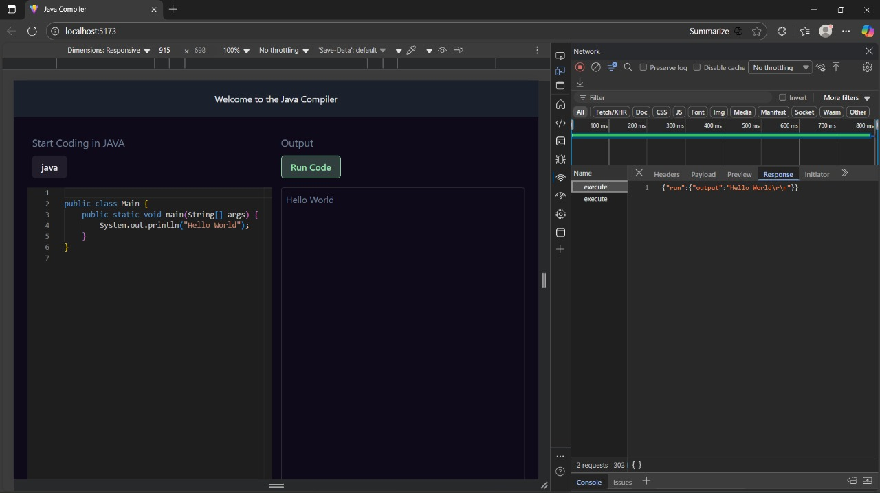
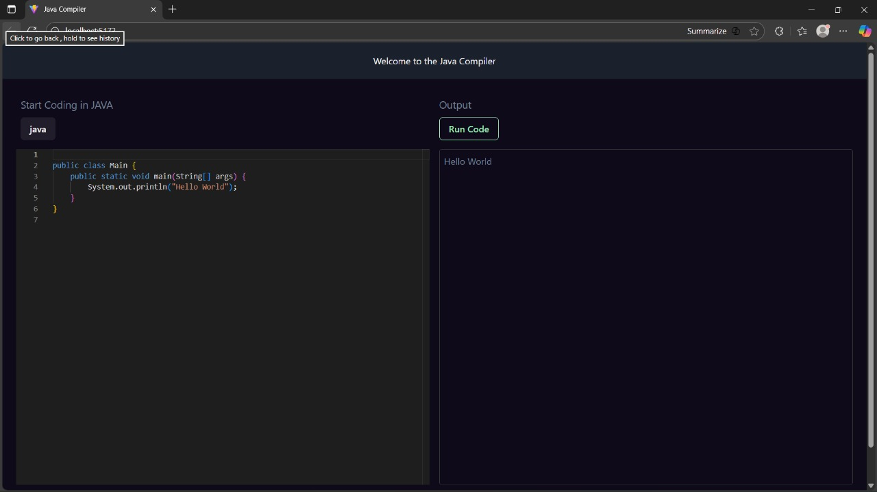
OUTPUT SCREENSHOT:

Slide 12
CONCLUSION:
The Java Web Compiler project provides an easy and efficient way for users to write, compile, and execute Java programs online without installing any software. It helps beginners and students practice Java coding directly through a web browser.
By using HTML, CSS, and JavaScript for the frontend and Node.js for the backend, the system offers a user-friendly interface and fast code execution. The project successfully demonstrates the integration of web technologies with Java programming.
Overall, this system makes Java programming more accessible, convenient, and time-saving, allowing users to focus on learning and problem-solving instead of setup and configuration.

Slide 13
THANK YOU

